Slide 1
BATTLE OF THE NEIGHBORHOODS
IREM FANOSÇU

Slide 2
INTRODUCTION
Shopping malls and casinos are the trademarks of American culture. In daily basis we all take a trip to malls for fulfill particular needs or entertain ourselves. Also casino’s are the one of the biggest part of US’s entertaintmet sector.

Slide 3
INTRODUCTION
My client ownes mall/casiono chains in Greece and he wants to open a new mall/casino in US. Fort he succes of his new venture, location is the key concept. My client has no prior information about mall / casiono sector or demographics in USA.

Slide 4
PROBLEM BROUGHT UP BY CLIENT
Which City and Locality is best to open a Casino/Shopping mall in USA?

Slide 5
ANALYTICAL APPROACH
According to the need of client first we have to find the City and then the Locality in that city for Business. To solve this particular problem and to gather data we will set few Benchmarks for the City and the locality in which opening a Casino/Shopping Mall would be Successful.

Slide 6
For discovering the City following benchmarks must meet
Nightlife
Services
Transport
Residence
Universities
Food
Entertainment
Travel
Outdoor Activities

Slide 7
Benchmarks for the Locality in City
Per Capıta Income
Population
Population Density
Venues

Slide 8
DATA REQUIREMENTS AND DESCRIPTION
List of all the cities in United States with population density and coordinates
List of all the cities in United States with Per Capita Income
List of all venues in each city
List of all venues in each locality in the selected city

Slide 9
SOURCE OF DATA
https://en.wikipedia.org/wiki/List_of_United_States_cities_by_population
https://en.wikipedia.org/wiki/List_of_United_States_counties_by_per_capita_income
Foursquare API

Slide 10
DATA DESCRIPTION
By Using the Wikipedia data we will first analyse the data and then focus on certain benchmarks to discover the best City in USA to open a Casino/Shopping mall. Then by leveraging the Foursquare data we will compare and try to find the best locality. Based on Scores we will try to determine the Locality in simillar way

Slide 11
DATA DESCRIPTION
About the State income levels: State income levels and income data for the United States as a whole are included for comparison. Note that county-equivalents in Louisiana are called "parishes" and in Alaska are called in "boroughs," and also that in Alaska census areas in the Unorganized Borough are county-equivalents. For states where independent cities are county-equivalents, the word "city" is included to identify the independent cities and to differentiate them from counties with identical names; the counties with the identical names have the word "county" following them. The word "county" is included in the names of counties that have names identical to the names of U.S. states or cities to differentiate them.

Slide 12
METHODOLOGY
1. Using Beautiful Soup Library Wikipedia pages containing information about Cities of USA by Population and Per Capita income are scraped into Pandas Dataframe.
2. Dataframe contained data about Cities, Coordinates, Area, Per capita Income and Population Density. Than Dataframe was Cleaned and Processed according to requirement of the problem to be solved. Proper benchmarks were set to obtain the best results.
3. The List of Venues in a City were obtained using Foursquare API and the city with maximum weight according to the Model is selected.
4. With the help of Unsupervised Machine Learning Algorithm (K Means Algorithm) Locality in the city is obtained where opening a Shopping Mall/Casino will be most benefitted.

Slide 13
RESULTS
Based on analysis we have done the results we obtain are – The plot shows the final location predicted by the Machine Learning Model –
For opening the Shopping mall/Casino
The Best city in USA – New Jersey
The best locality in New Jersey – Jersey Avenue

Slide 14
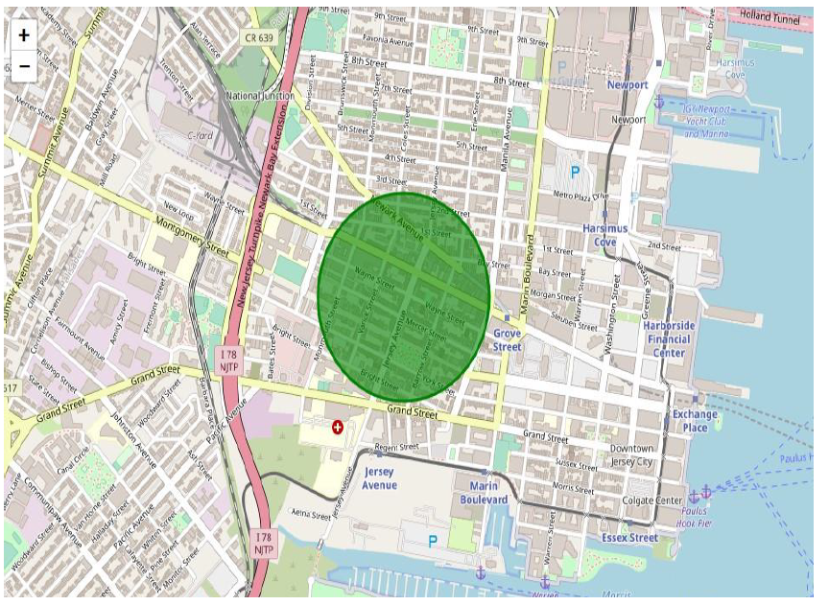

Slide 15
DISCUSSIONS AND IMPROVEMENTS
In the Four-Square API, we have queried the Venues of a locality by specifying the LIMIT and Radius of our choice. We have chosen less LIMIT as the number of API calls that can be done using a free account in Four Square are less. We can increase the limit for more accurate results.

Slide 16
DISCUSSIONS AND IMPROVEMENTS
In the venue categories we are choosing only few out of 2000 that are available to give weights and identify the best cluster. Hence, assigning weights must be done relatively for each category and then considering a greater number of venue categories would actually yield better output.

